Slide 1

Undefined Pair
Indian Institute Of Technology Madras
An AI-powered health chatbot revolutionizing early disease detection with instant, affordable, and accurate care guidance.

Slide 2



Healthcare accessibility challenges:
High diagnostic costs.
Lack of immediate support for preliminary symptoms.
Insufficient guidance is needed to detect serious illnesses (e.g., cancer, heart conditions).
Limited awareness of common health issues (e.g., fever, vitamin deficiencies, infections).
Patients delay seeking medical attention due to:
Confusion about symptoms.
Uncertainty regarding necessary diagnostic tests.
Delayed medical attention often leads to worsened health outcomes.

Slide 3


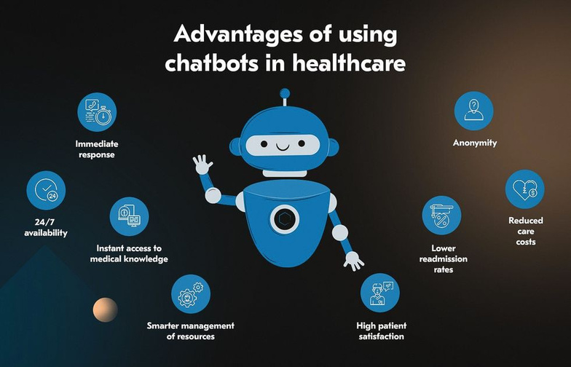
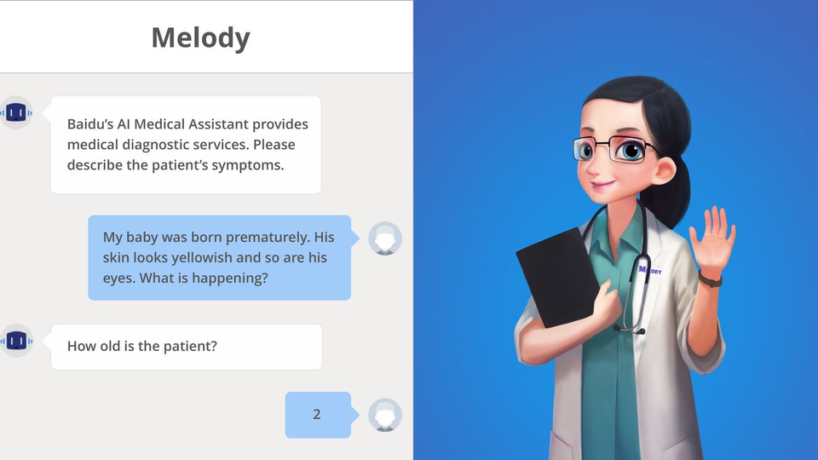

How it works: Users interact with the chatbot by inputting symptoms.
The chatbot categorizes symptoms into common health issues, deficiencies, infectious diseases, and serious conditions.
Provides personalized recommendations based on symptoms and family history.
Example: If a user reports fever and cough, the chatbot suggests a common cold or flu diagnosis, with next steps (e.g., over-the-counter medication).

Slide 4
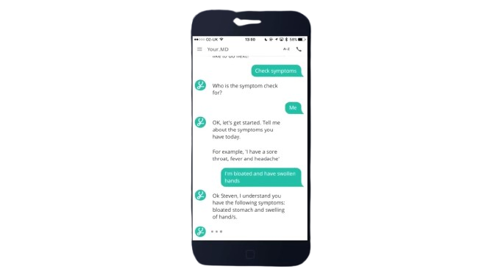
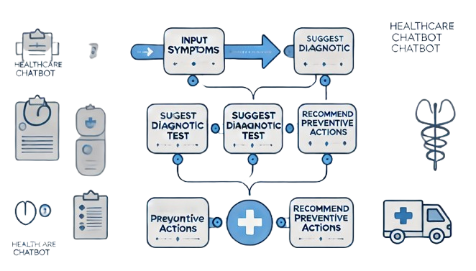

The chatbot also suggests necessary tests based on detected symptoms.
Example:
For iron deficiency symptoms, an iron blood test is recommended;
For heart disease, it suggests an ECG.
Family history integration raises the priority for certain tests (e.g., cancer, heart disease) based on inherited risks.
Recommends preventive steps like lifestyle changes or regular health checks.

Slide 5
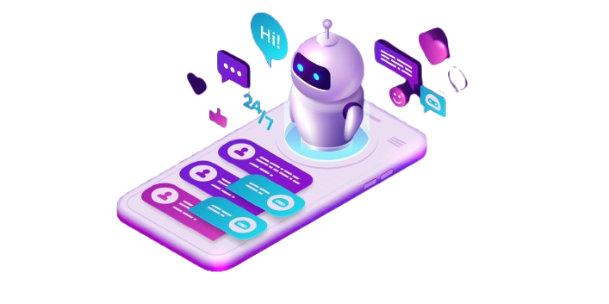

Core technologies:
Chatbot AI: Use of Natural Language Processing (NLP) for understanding user inputs.
Backend: Database to store user data (symptoms, family history, test recommendations).
Frontend: Easy-to-use interface for both web and mobile platforms.
Integration with medical databases for accurate test recommendations.
Security: Data encryption and privacy measures to protect sensitive user data.
Data Encryption

Slide 6

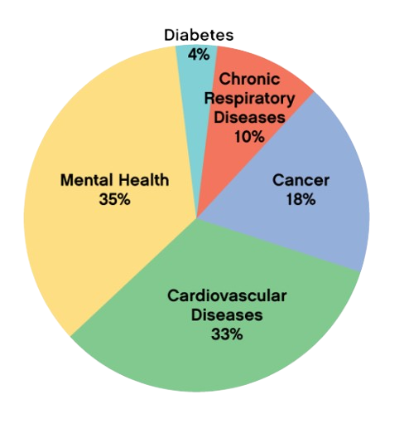
Primary users: Individuals seeking quick, affordable health advice and those without easy access to healthcare professionals.
Target demographics:
People with chronic conditions or family history of diseases (e.g., heart disease, cancer).
Rural or underserved populations with limited access to healthcare.
Young adults and tech-savvy individuals looking for health guidance.
Market size: Provide figures for the potential market (e.g., number of people with chronic diseases, growing health awareness).
People suffering from diseases

Slide 7

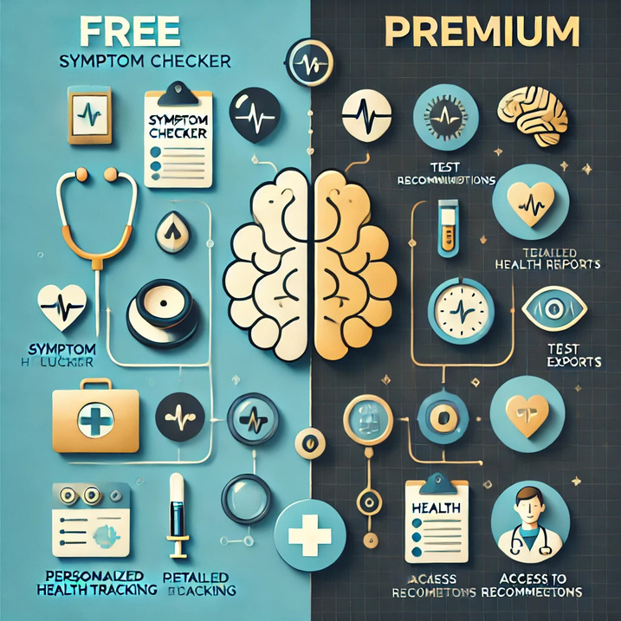
Freemium Model:
Free version: Basic symptom checking and test recommendations.
Premium version: Advanced features like detailed health reports, AI-based personalized health tracking, and access to health professionals.
Partnerships: Collaborate with medical facilities and labs for discounted tests.
Affiliate marketing: Offer products like vitamins, health supplements, or medical devices through the app.
In-app advertising: Ads related to health and wellness products.
Business Model

Slide 8
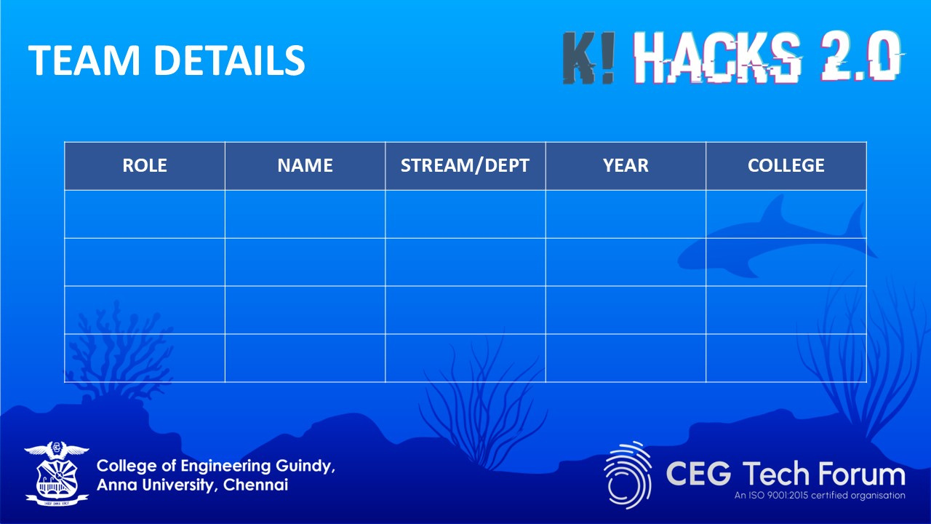

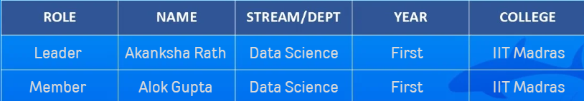
“Empowering healthcare through timely intervention—because early detection saves lives.”
Thank You

